Slide 1
Leech / LTTng TrcCode
Jason Puncher
Software Designer
Apriil 20, 2016

Slide 2
LTTng Tracing Code (Today)
The GNU compiler has a compile option "-finstrument-functions" which generates instrumentation calls for the entry and exit functions. On every entry into a function, and just before returning from a function the following routines will be called:
Each will be provided the starting address of the function that is being executed (this_fn) as well as the address from which the function was called (call_site).
void __cyg_profile_func_enter (void *this_fn, void *call_site);
void __cyg_profile_func_exit (void *this_fn, void *call_site);

Slide 3
LTTng TrcCode – Static Function Instrumentation Flow
LD_PRELOAD Library

Slide 4
LTTng Tracing Code (Today)
LTTng, with the help of the "LD_PRELOAD" environment variable, can load its own shared object file to replace the generated entry and exit functions. These function would then log the function entry and exit in LTTng. A sample trace of the output would look as follows:
[18:47:20.956030535] (+?.?????????) (none) lttng_ust_cyg_profile:func_entry: { cpu_id = 0 }, { vtid = 3586, procname = "bbb_Upgrade" }, { addr = 0x…, call_site = 0x… }
[18:47:20.956104596] (+0.000074061) (none) lttng_ust_cyg_profile:func_entry: { cpu_id = 0 }, { vtid = 3586, procname = "bbb_Upgrade" }, { addr = 0x…, call_site = 0x… }
[18:47:20.956124114] (+0.000019518) (none) lttng_ust_cyg_profile:func_exit: { cpu_id = 0 }, { vtid = 3586, procname = "bbb_Upgrade" }, { addr = 0x…, call_site = 0x… }
[18:47:20.956130907] (+0.000006793) (none) lttng_ust_cyg_profile:func_entry: { cpu_id = 0 }, { vtid = 3586, procname = "bbb_Upgrade" }, { addr = 0x…, call_site = 0x… }

Slide 5
LTTng Tracing Code (Today)
This is great! But it has its limitations:
requires a recompile of the code to insert the calls to the generated entry/exit functions
logging will be done on all threads within a process
there lacks an ability to insert trigger points on which to commence tracing (tracing will start when "lttng start" is called)

Slide 6
LTTng Tracing Code (with Leech)
Leech can be used to address these shortcomings. It provides the ability to:
dynamically instrument the code (inserting tracepoints to the entry and exit routines without recompiling)
select individual threads on which to capture function entry/exit events
trigger the start of the collection when a particular routine is called
stop tracing when either the start routine returns, or when a specified function is called

Slide 7
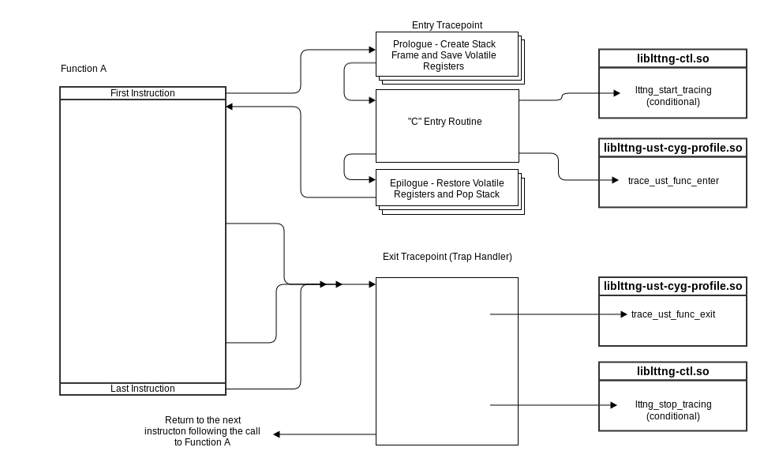
LTTng TrcCode – Dynamic Function Instrumentation Flow
Notes:
The steps required to install the tracepoints is broken down as follows:
1.Dynamically load the required shared objects (liblttng-ust-cyg-profile.so, liblttng-ctl.o) inside the process.
2.Generate and copy the tracepoint code to the target memory.
3.Enable the tracepoint code, by replacing the first and last instruction of very function with a branch to the tracepoint. On x86, we use a trap instruction on the return, and call the tracepoint from the trap signal handler.

Slide 8
LTTng TrcCode – Dynamic Function Instrumentation Flow
3 - Enabling Instrumentation
2 - Tracepoint Generation and Installation
1 - Load Dynamic Libraries

Slide 9
LTTng TrcCode - Tasks
To accomplish these tasks we need to be able to:
Halt thread execution, in order to modify its source.
Make remote procedure calls in order to call :
dlopen : to load shared libraries
dlsym : to lookup symbol addresses (in shared libraries)
mmap : to allocate memory (in which to copy tracepoints)
ect…
Modify process memory in order to :
copy the tracepoint code into the processes memory map
modify the source in order to insert branches to the newly introduced tracepoints
This is accomplished using ptrace.

Slide 10
LTTng TrcCode – ptrace
The ptrace() system call provides a means by which to observe and control the execution of another process. With it you can change the image, and process registers.
#include <sys/ptrace.h>
long ptrace(enum __ptrace_request request, pid_t pid,
void *addr, void *data);
Request | Description
PEEKUSR, POKEUSR | Read/Write process data.
PEEKDATA , POKEDATA | Read/Write process memory.
ATTACH/DETACH | Attach to process, making the calling process the trace parent. This call will send a SIGSTOP to the process.
PTRACE_SINGLESTEP | Continues process until exit from system call, or after execution of single instruction.
PTRACE_CONT | Restarts stopped child process

Slide 11
LTTng TrcCode – Remote Procedure Call (using ptrace)
After suspending a thread, we:
Push argument data on the stack
Push a trap instruction
Then create a stack frame as would the compiler:
push PC
push FP
push arguments
Push the EIP normally done by the processor on processing the call instruction.
Address pushed is that of trap instruction.
Notes:
Use ptrace() to peek/poke registers and memory. Allowing us to overwrite instructions with branches to our tracepoints. But we must also allocate memory in which to copy our tracepoints. As well as dynamically load the shared objects which contain the API's to start tracing and log our events. To do so we must be able to call functions such as "mmap" and "dlopen" within the target process. Here is how it is done:
As always, when playing around with a process stack, or registers we must attach to a thread within the process. Once attached we save all registers, as they will be changing. Then we must push the function call arguments onto the stack.
In addition to the function data, and arguments, we puch a TRAP instruction. The return instruction pointer (x86) or Link Register (PowerPC) is modified to point to this stack address. As a result a trap will be generated upon returning from the function call. At this point the threads register data is restored and is allowed to resume.

Slide 12
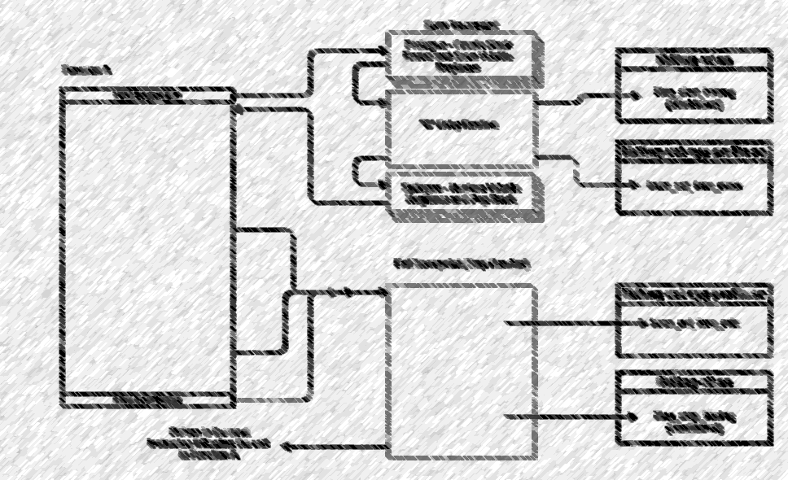
LTTng TrcCode – Loading Dynamic Libraries
Notes:
Dynamically load the required shared objects (liblttng-ust-cyg-profile.so, liblttng-ctl.o) inside the process.
liblttng-ctl – to conditionally start/stop LTTng
liblttng-ust-cyg-profile – to load the routines that would have otherwise replaced the _cyg_profile enter/exit stubs
Done by remotely calling dlopen in the target process (necessitates having the libdl shared object linked to target).

Slide 13
LTTng TrcCode – Tracepoint Generation / Installation
Notes:
Generate and copy the tracepoint code to the target memory.
Entry tracepoint :
x
Exit tracepoint (trap handler):
Y
On the x86 target, the function exit tracepoint is in fact a signal handler. Branching from the return instruction address is complicated by the fact that it is a single byte instruction. It is not easily replaced by a call instruction that is 5 bytes long. Instead it is replaced by a trap instruction.

Slide 14
LTTng TrcCode – Tracepoint Generation (x86)

Slide 15
LTTng Tracing Code - Tracepoint Installation
Now that we have our tracepoints. It's time to copy them over to the process memory. For this we need space, and for that we look at the processes memory map:
bash-4.1# cat /proc/3550/maps
00100000-00102000 r-xp 00000000 00:00 0 [vdso]
0f9c0000-0fb34000 r-xp 00000000 08:01 428263 /lib/libc-2.14.1.so
0fb34000-0fb43000 ---p 00174000 08:01 428263 /lib/libc-2.14.1.so
0fb43000-0fb45000 r--p 00173000 08:01 428263 /lib/libc-2.14.1.so
0fb45000-0fb48000 rwxp 00175000 08:01 428263 /lib/libc-2.14.1.so
0fb48000-0fb4b000 rwxp 00000000 00:00 0
0fb5b000-0fb74000 r-xp 00000000 08:01 428349 /lib/libgcc_s.so.1
...
0ff2e000-0ff2f000 r--p 0000a000 08:01 251006 /usr/lib/libmemTrace.so
0ff2f000-0ff30000 rwxp 0000b000 08:01 251006 /usr/lib/libmemTrace.so
0ff30000-0fff0000 rwxp 00000000 00:00 0
*** unreseved memory ***
10000000-10342000 r-xp 00000000 08:01 10386 bin/bbb-xc
10351000-103a9000 rwxp 00341000 08:01 10386 bin/bbb-xc
103a9000-105ab000 rwxp 00000000 00:00 0 [heap]
*** unreseved memory ***
48000000-4801f000 r-xp 00000000 08:01 428346 /lib/ld-2.14.1.so

Slide 16
LTTng TrcCode – Enabling Instrumentation
Notes:
Enable the tracepoint code, by replacing the first and last instruction of very function with a branch to the tracepoint. On x86, we use a trap instruction on the return, and call the tracepoint from the trap signal handler.

Slide 17
LTTng Tracing Code - Enabling Instrumentation
Until this point we have not altered execution or impacted the performance of the target process. Now we must insert the jump instructions at the start of every function to there matching tracepoint. As well as replace all ‘ret’ instructions with a trap instruction.
Suspend all threads in process by attaching via ptrace.
x86 target requires 5 byte jump instruction
We must ensure the program counter, once stopped, does not reside in any 5 byte block of memory that will be overwritten by the jump instruction.
Resume, and re-attach until safe.
Ensure that no instruction inside a function results in a jump to an offset spanned by the jump to the tracepoint.
bash-4.1# ls /proc/3550/task
3550 3765 3767 3769 3771 3774 3776 3778 3780 3782 4026 4028 4030
3567 3766 3768 3770 3772 3775 3777 3779 3781 3783 4027 4029 6910
Notes:
Until this point we have not altered execution or impacted the performance of the target process. Now we must insert the branch/jump instructions at the start of every function to there matching tracepoint.
For each thread, we use ptrace to attach to the thread. This will halt the thread.
On the x86 target, the jump instruction is 5 bytes in size. However, x86 instructions can be as little as a single byte. We must ensure that the threads program counter, once stopped, does not fall in the 5 byte block of memory that will be overwritten by the jump instruction. If it does, we resume the thread and re-attach. This is simpler than single stepping through the code.

Slide 18
LTTng TrcCode – Dynamic Function Instrumentation Flow

Slide 19
Thank You

